Slide 1
Virtual Functions
1
Chapter 10

Slide 2
Objectives
Polymorphism in C++
Pointers to derived classes
Introduction to virtual functions
More about virtual functions
Applying polymorphism
2

Slide 3
Polymorphism in C++
2 types
Compile time polymorphism
Uses static or early binding
Example: Function and operator overloading
Run time polymorphism
Uses dynamic or early binding
Example: Virtual functions
3

Slide 4
Pointers to Derived Classes
A pointer declared as a pointer to a base class can also be used to point to any class derived from that base. For example, assume two classes called base and derived, where derived inherits base.
Given this situation, the following statements are correct: base *p; // base class pointer base base_ob ; // object of type base derived derived_ob ; // object of type derived // p can , of course , point to base objects p = & base_ob ; // p points to base object // p can also point to derived objects without error p = & derived_ob ; // p points to derived object
4

Slide 5
Pointers to Derived Classes (contd.)
Although you can use a base pointer to point to a derived object, you can access only those members of the derived object that were inherited from the base.
This is because the base pointer has knowledge only of the base class. It knows nothing about the members added by the derived class.
While it is permissible for a base pointer to point to a derived object, the reverse is not true. A pointer of the derived type cannot be used to access an object of the base class.
5

Slide 6
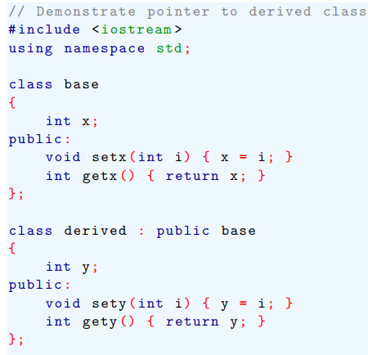
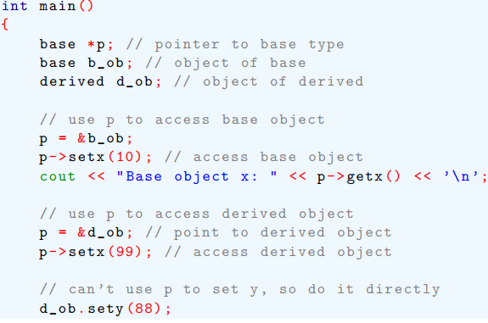
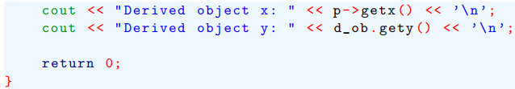
Pointers to Derived Classes (contd.)
Here is a short program that illustrates how a base class pointer can be used to access a derived class:
6

Slide 7
Introduction to Virtual Functions
A virtual function is a member function that is declared within a base class and redefined (called overriding) by a derived class.
It implements the “one interface, multiple methods” philosophy that underlies polymorphism.
The keyword virtual is used to designate a member function as virtual.
Supports run-time polymorphism with the help of base class pointers.
7

Slide 8
Introduction to Virtual Functions (contd.)
While redefining a virtual function in a derived class, the function signature must match the original function present in the base class.
So, we call it overriding, not overloading.
When a virtual function is redefined by a derived class, the keyword virtual is not needed (but can be specified if the programmer wants).
The “virtual”-ity of the member function continues along the inheritance chain.
A class that contains a virtual function is referred to as a polymorphic class.
8

Slide 9
Introduction to Virtual Functions (contd.)
class base {
public:
virtual void show() {
cout << “base\n”;
}
};
class derived : public base {
public:
void show() {
cout << “derived\n”;
}
};
void main() {
base b1;
b1.show(); // base - (s.b.)
derived d1;
d1.show(); // derived – (s.b.)
base *pb = &b1;
pb->show(); // base - (d.b.)
pb = &d1;
pb->show(); // derived (d.b.)
}
Here,
s.b. = static binding
d.b. = dynamic binding
9

Slide 10
Introduction to Virtual Functions (contd.)
class base {
public:
virtual void show() {
cout << “base\n”;
}
};
class d1 : public base {
public:
void show() {
cout << “derived-1\n”;
}
};
class d2 : public base {
public:
void show() {
cout << “derived-2\n”;
}
};
void main() {
base *pb; d1 od1; d2 od2;
int n;
cin >> n;
if (n % 2) pb = &od1;
else pb = &od2;
pb->show(); // guess what ??
}
10
Run-time polymorphism

Slide 11
More About Virtual Functions
If we want to omit the body of a virtual function in a base class, we can use pure virtual functions.
virtual ret-type func-name(param-list) = 0;
It makes a class an abstract class.
We cannot create any objects of such classes.
It forces derived classes to override it.
Otherwise they become abstract too.
11

Slide 12
More About Virtual Functions (contd.)
Pure virtual function
Helps to guarantee that a derived class will provide its own redefinition.
We can still create a pointer to an abstract class
Because it is at the heart of run-time polymorphism
When a virtual function is inherited, so is its virtual nature.
We can continue to override virtual functions along the inheritance hierarchy.
12

Slide 13
Final Comments
Run-time polymorphism is not automatically activated in C++.
We have to use virtual functions and base class pointers to enforce and activate run-time polymorphism in C++.
But, in Java, run-time polymorphism is automatically present as all non-static methods of a class are by default virtual in nature.
We just need to use superclass references to point to subclass objects to achieve run-time polymorphism in Java.
13

Slide 14
Applying Polymorphism
Early binding
Normal functions, overloaded functions
Nonvirtual member and friend functions
Resolved at compile time
Very efficient
But lacks flexibility
Late binding
Virtual functions accessed via a base class pointer
Resolved at run-time
Quite flexible during run-time
But has run-time overhead; slows down program execution
14

Slide 15
Lecture Contents
Teach Yourself C++
Chapter 10 (Full, with exercises)
Study the examples from the book carefully
15

